Slide 1
Recurrent GANs
Víctor Uc Cetina

Slide 2
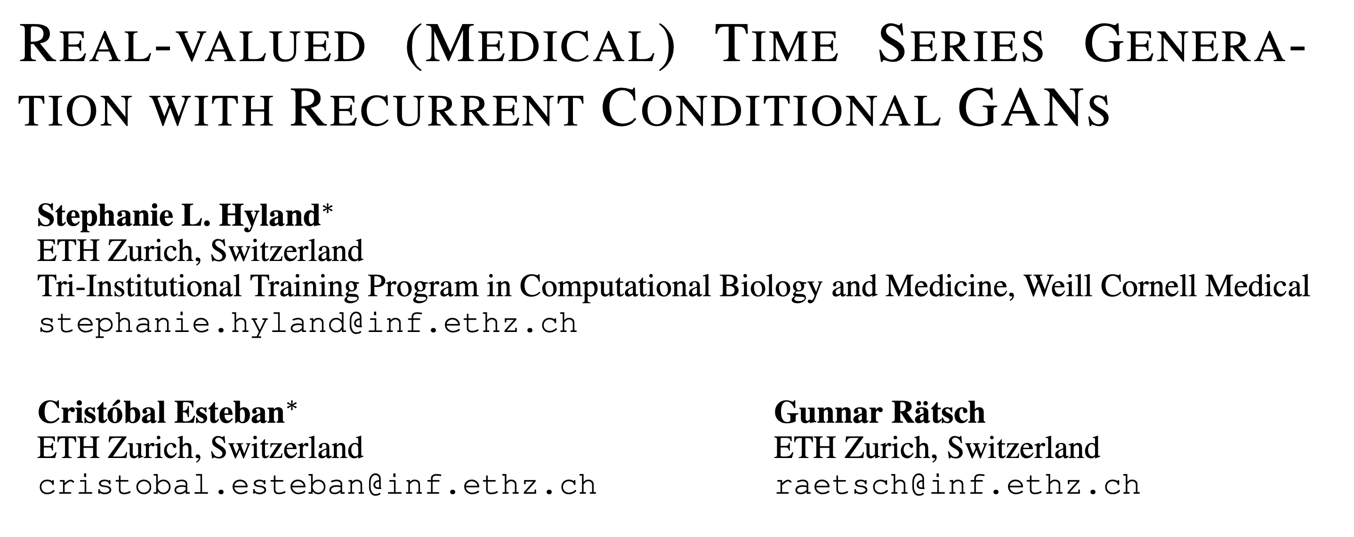
Arxiv, 2017

Slide 3
Main points of the paper
Use of GANs to generate real-valued time series, for medical purposes: RGANs and RCGANs.
It uses recurrent neural networks for both encoder and decoder (specifically LSTMs).
Generation of time series from ICU patients, using the open-access eICU dataset.
Also, generation of some non-medical time-series, like sine waves and smooth functions sampled from Gaussian Processes, and MNIST digits (imagined as a time series).

Slide 4
Motivation
Sharing medical data is hard, because it comes from real people, and is naturally highly sensitive (not to mention legally protected).
One workaround for this difficultly would be to create sufficiently realistic synthetic data.
This synthetic data could then be used to reproducibly develop and train machine learning models, enabling better science, and ultimately better models for medicine.

Slide 5
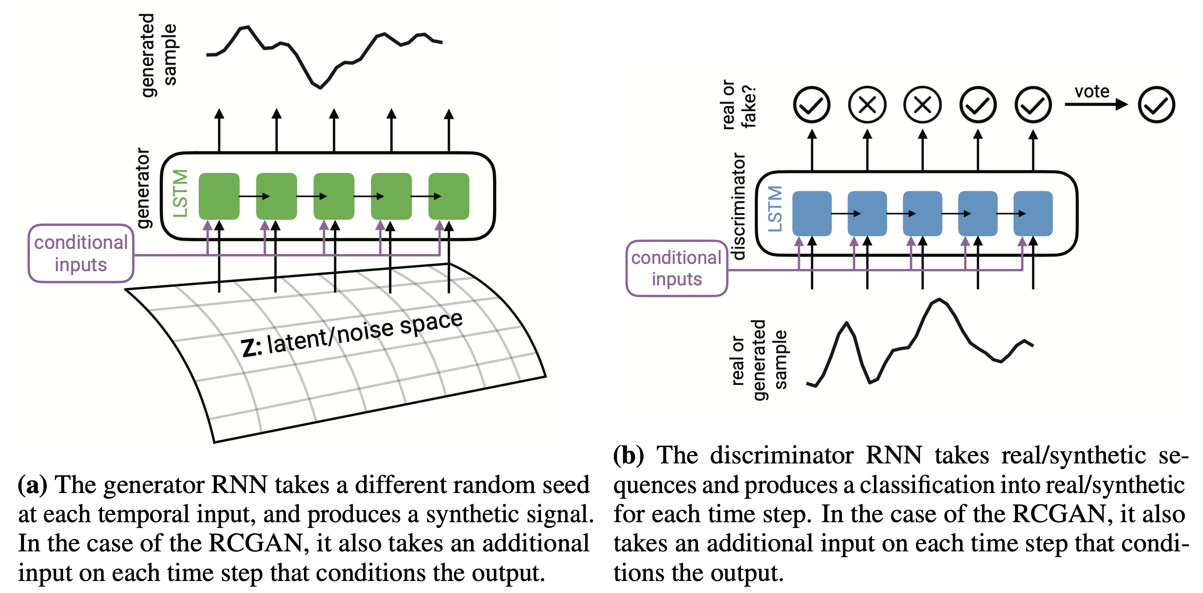
Recurrent GAN Architecture

Slide 6
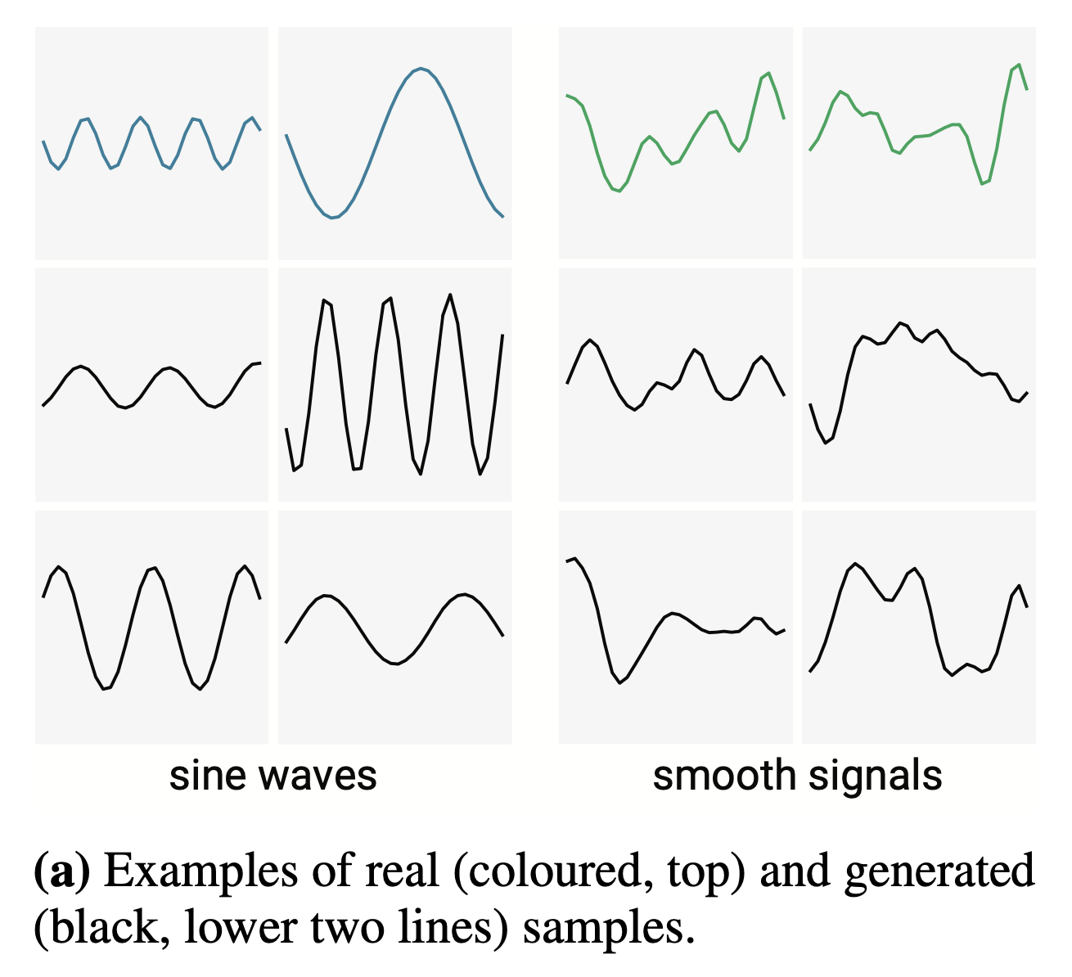
Experiments with sines functions

Slide 7
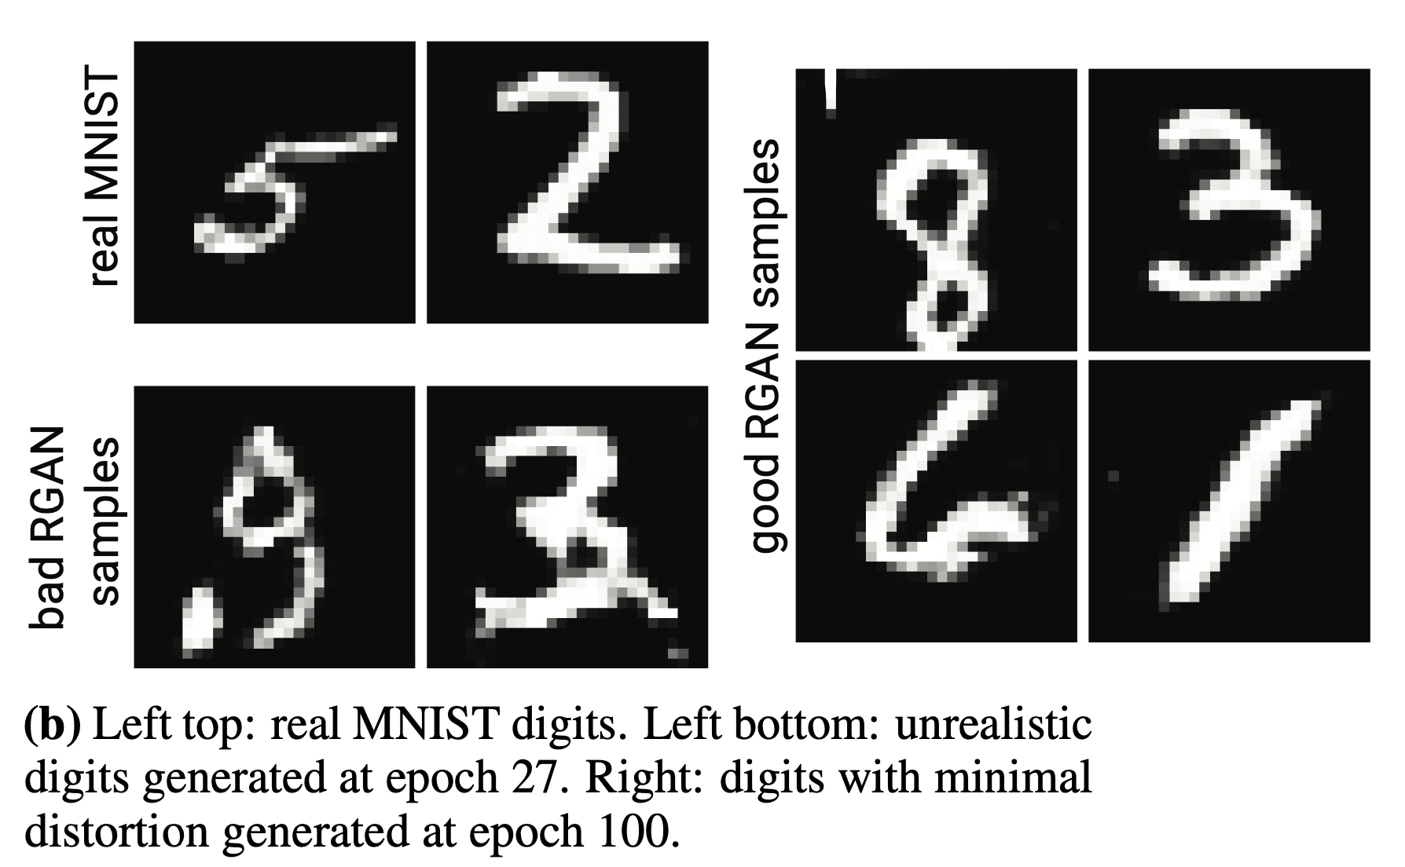
Experiments with serialized MNIST

Slide 8
Realistic ICU data
Philips eICU https://eicu-crd.mit.edu/
200,000 patients from 208 care units across the US, with a total of 224,026,866 entries divided in 33 tables.
Four most frequently recorded, regularly-sampled variables measured by bedside monitors:
oxygen saturation measured by pulse oximeter (SpO2),
heart rate (HR),
respiratory rate (RR) and
mean arterial pressure (MAP)

Slide 9
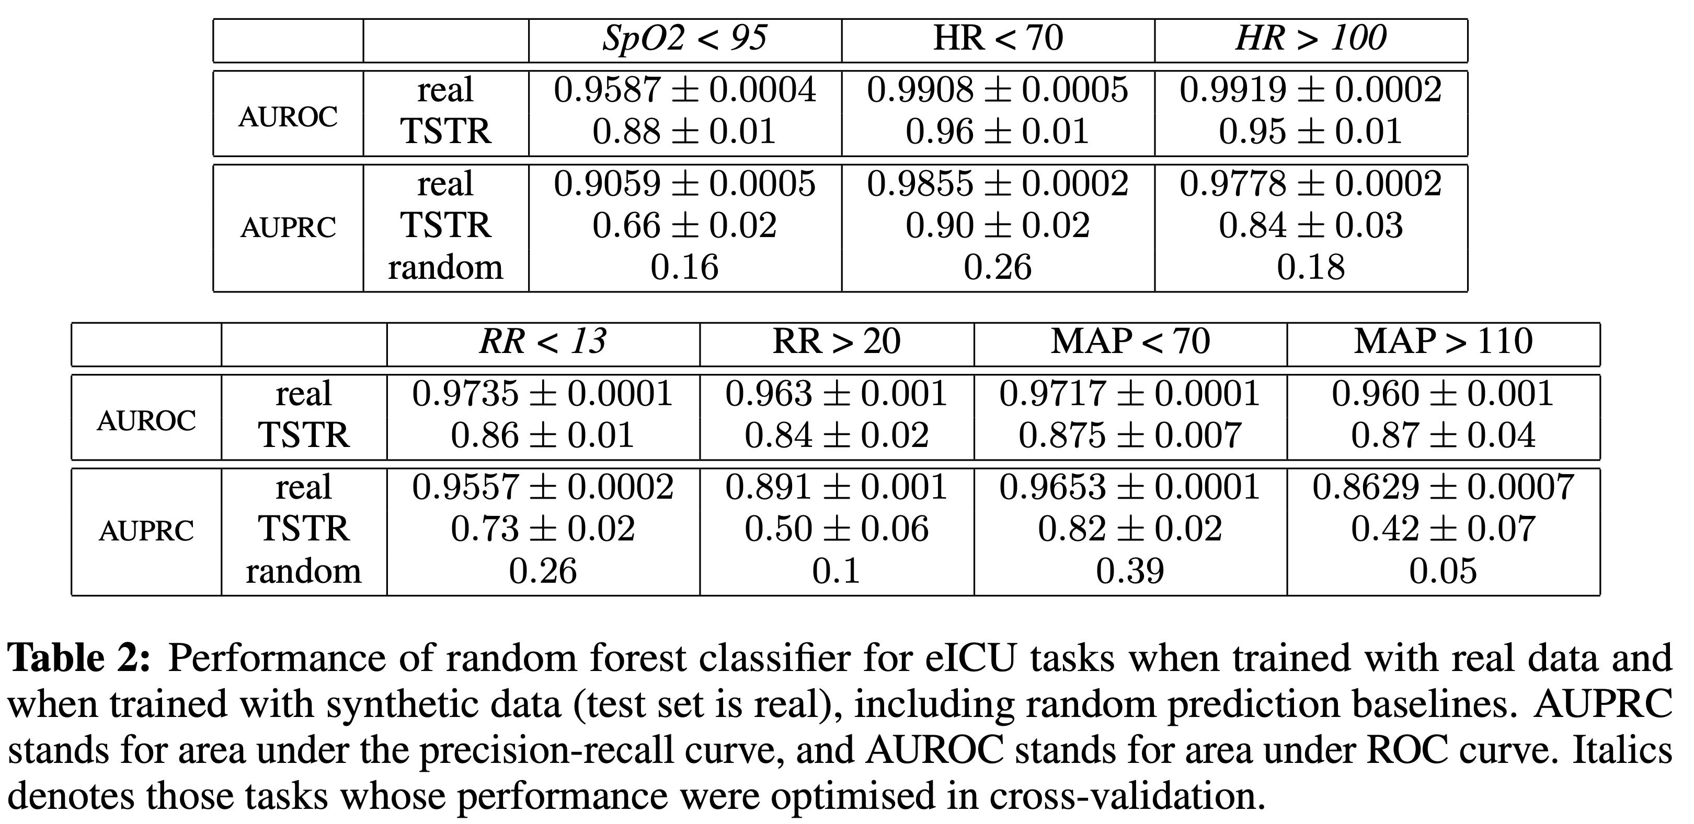
Realistic ICU data - performance

Slide 10
Recurrent GANs for time series and sequence generation

Slide 11
GANs for polyphonic music
Generation of polyphonic music as real-valued continuous sequential data using a LSTM in both the generator and discriminator.
O. Mogren, “C-RNN-GAN: Continuous recurrent neural networks with adversarial training,” Arxiv, 2016.

Slide 12
GANs for synthetic music by representing 88 distinct pitches with discrete tokens
This GAN, called SeqGAN, contained a LSTM in the generator with a CNN in the discriminator and outperformed alternative approaches for generating sequences of data.
L. Yu, W. Zhang, J. Wang, and Y. Yu, “SeqGAN: Sequence generative adversarial nets with policy gradient,” 31st AAAI Conference on Artificial Intelligence, AAAI 2017.

Slide 13
GANs for raw waveform audio (WaveGAN)
WaveGAN was created by altering the architecture of the DCGAN.
It was used to generate realistic drum beats, bird song and speech-like babble similar to those produced by unconditional autoregressive models.
C. Donahue, J. McAuley, and M. Puckette, “Adversarial Audio Synthesis,” Arxiv, 2018.

Slide 14
GANs for electroencephalogram (EEG) data
GANs were used to generate single-channel EEG data for motor movement in both the left and right hand.
K. G. Hartmann, R. T. Schirrmeister, and T. Ball, “EEG-GAN: Generative adversarial networks for electroencephalograhic (EEG) brain signals,” Arxiv, 2018.
F. Zhu, F. Ye, Y. Fu, Q. Liu, and B. Shen, “Electrocardiogram generation with a bidirectional LSTM-CNN generative adversarial network,” Scientific Reports, vol. 9, no. 1, pp. 1–11, 2019.
A. M. Delaney, E. Brophy, T. E. Ward. Synthesis of realistic ECG using generative adversarial networks, 2019.

Slide 15
Related recurrent approaches for image/drawing generation

Slide 16
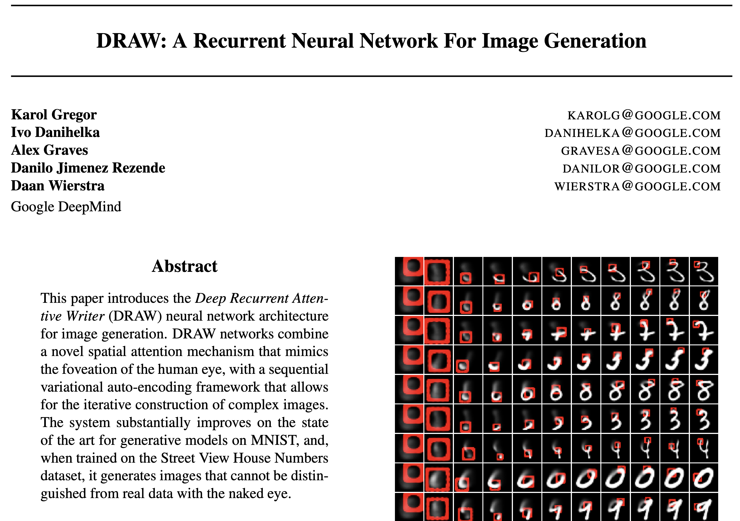
2015

Slide 17
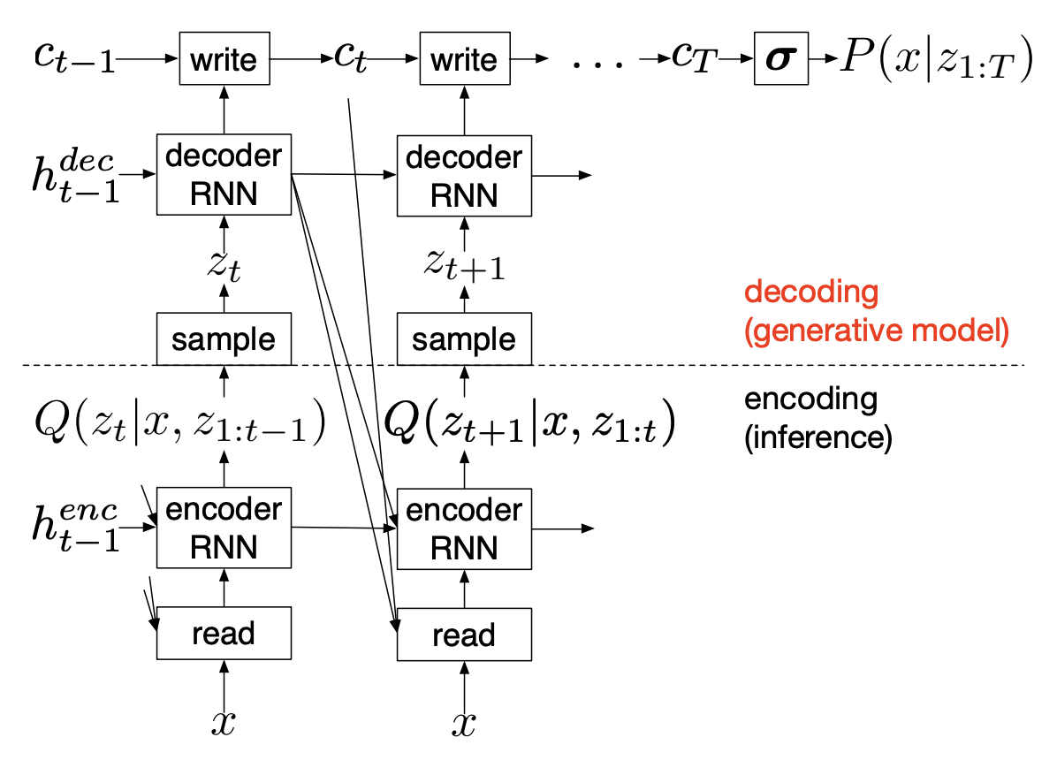
Draw architecture

Slide 18
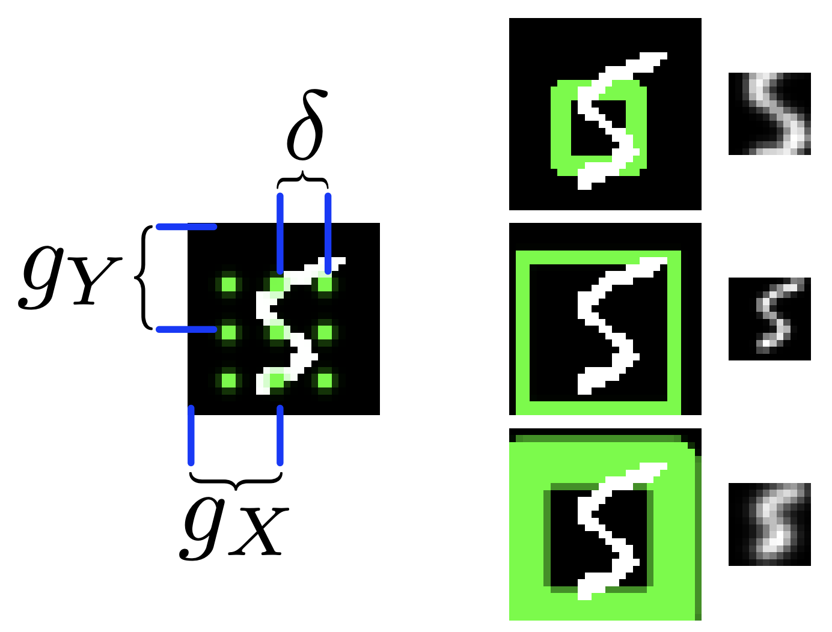
Draw filters

Slide 19
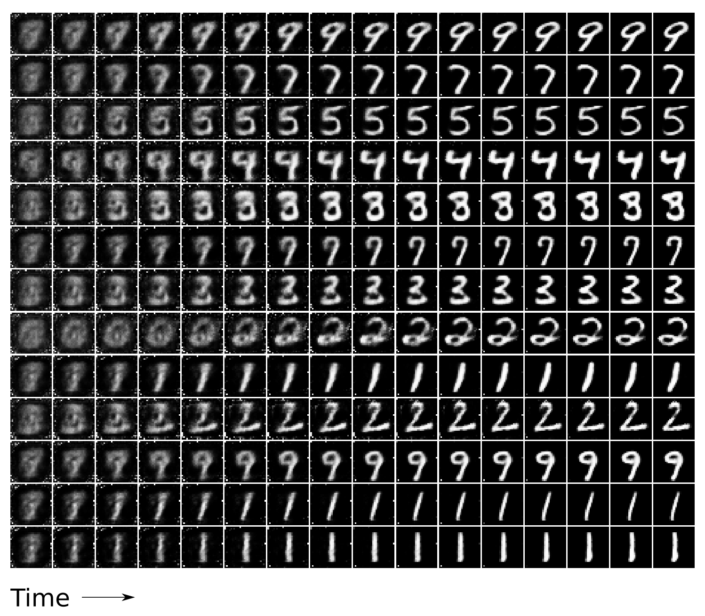
Draw example 1

Slide 20
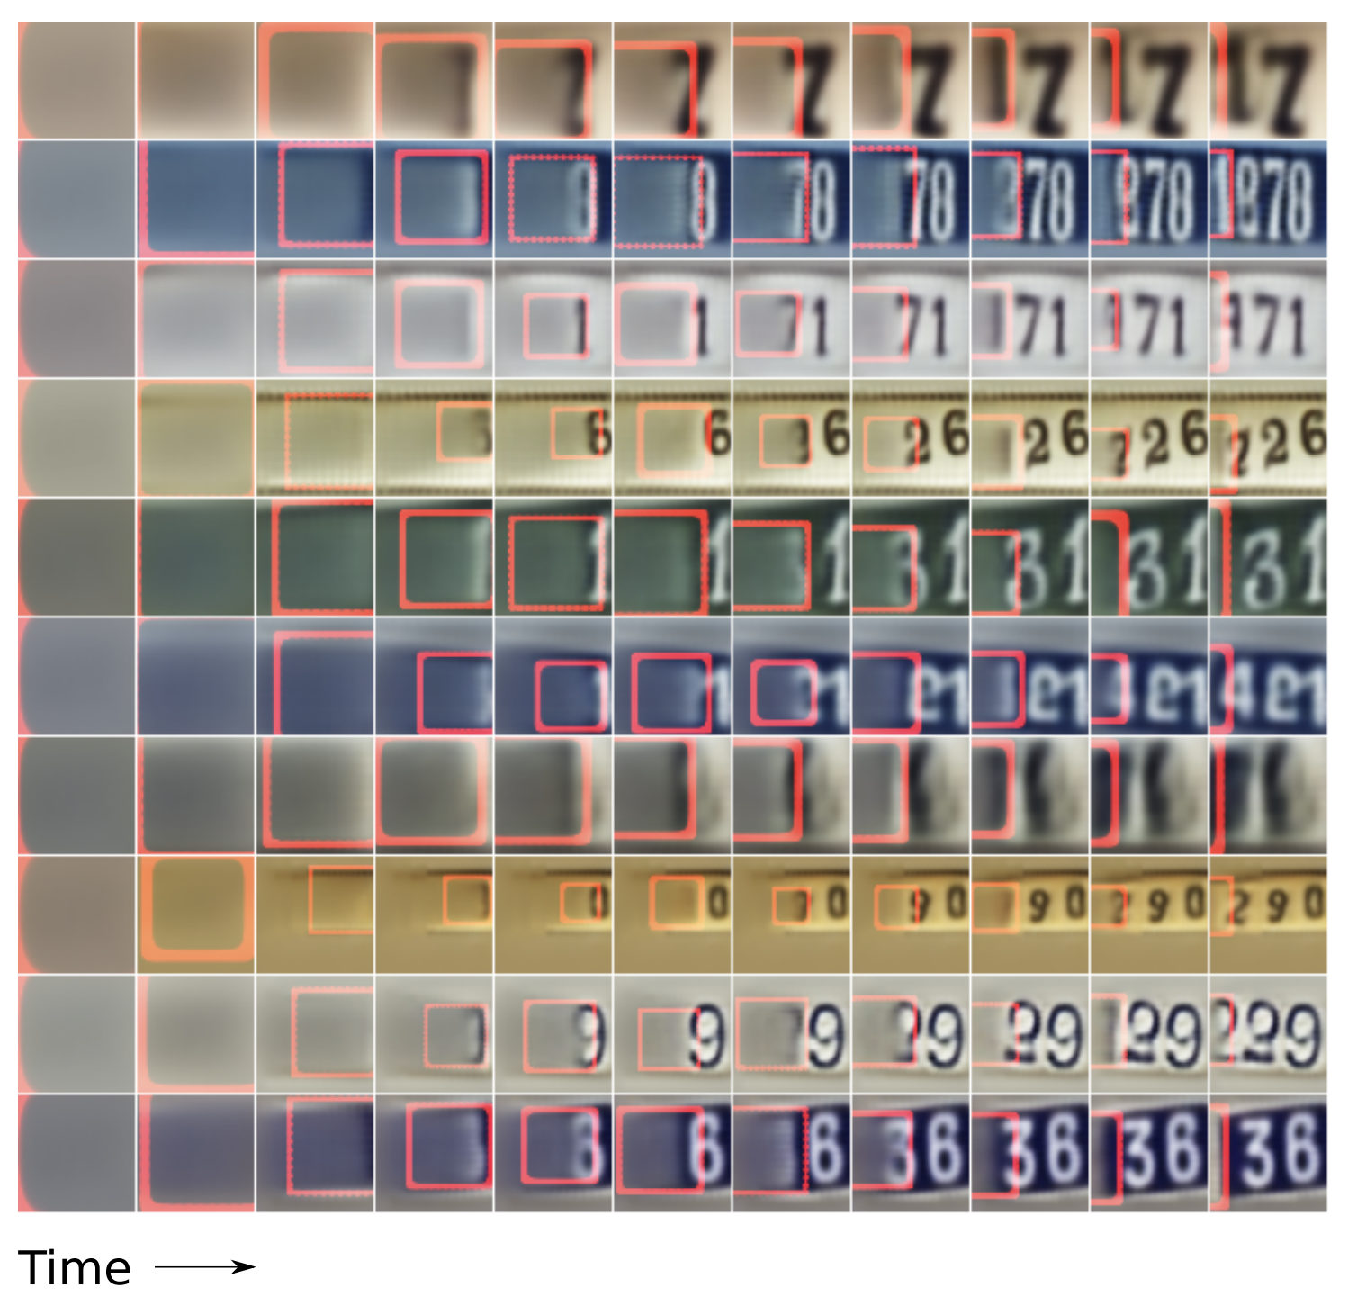
Draw example 2

Slide 21
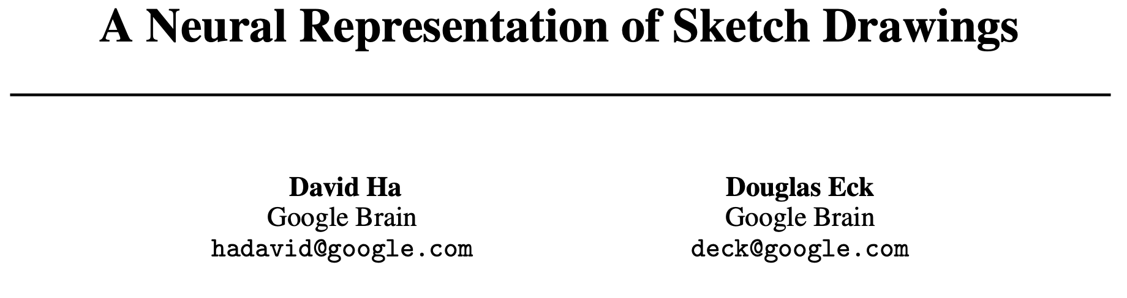
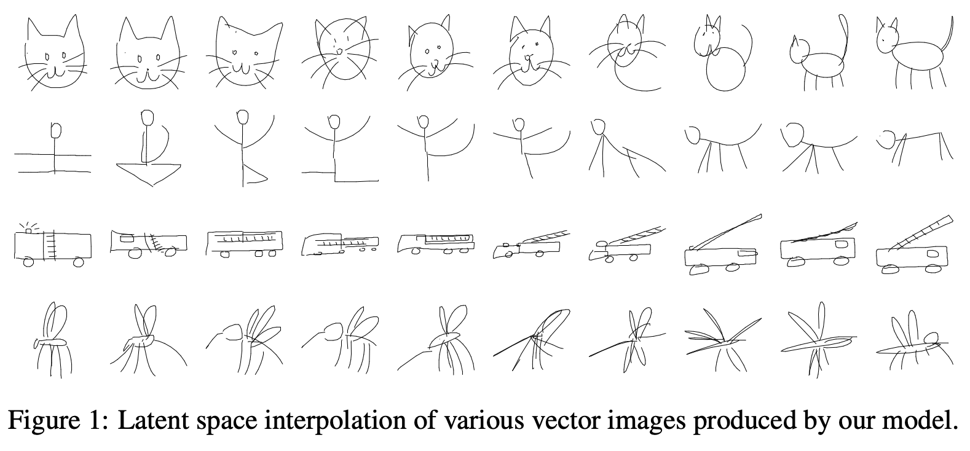
2017
Online demo: https://magenta.tensorflow.org/assets/sketch_rnn_demo/index.html

Slide 22
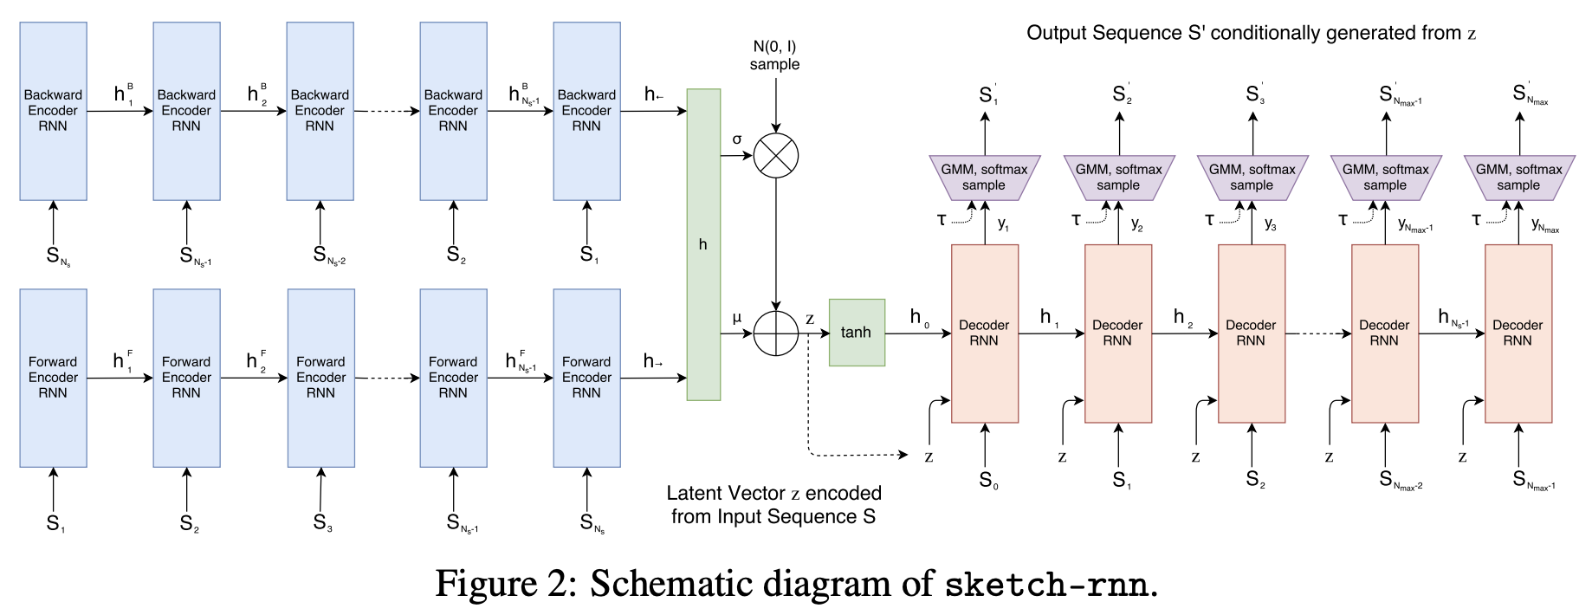
Sketch-RNN architecture

Slide 23
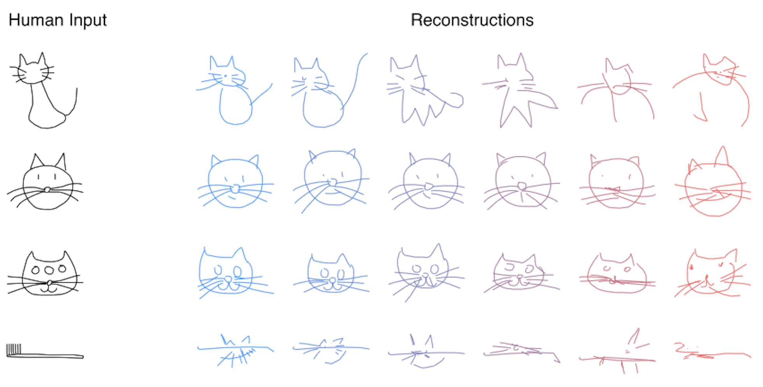
Sketch example 1

Slide 24
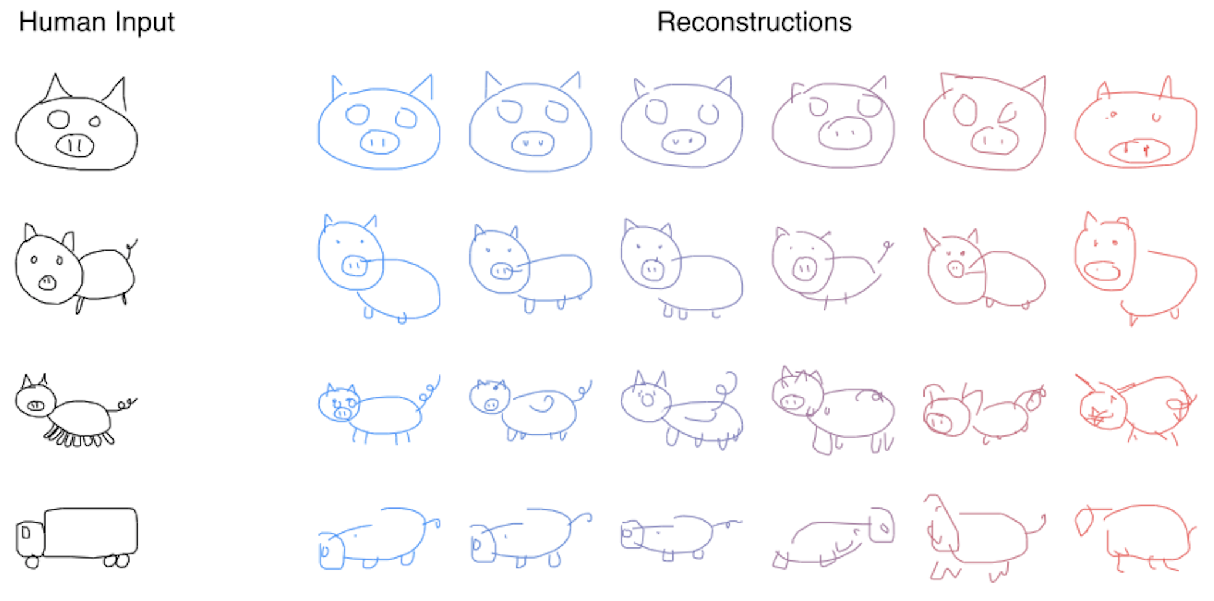
Sketch example 2

Slide 25
Thank you! Víctor Uc Cetina victoruccetina@gmail.com

